Slide 1
Simplify finance operations with Ramp and Netgain
A NetSuite user’s path to success

Slide 2
Speakers
Tanner Larsen
Nigel Reiff
Gabriel Rogoff
Partnerships Managerr
Solutions Consultant
Technical Consultant
Certified Public Accountant
Former auditor with Big 4 and other CPA firms
Implemented ERPs and FP&A tools for 4 years
Implemented NetSuite for 4 years at Oracle and Deloitte
Ramp.com technical consultant
Tanner K. Larsen
Nigel Reiff
Gabriel Rogoff
Notes:
Replace with Ramp + Netgain Headshots

Slide 3
Simplify Finance Operations
NetGain refresher
Ramp introduction
Challenges in spend management
Ramp overview demo
Ramp + Netgain (Shared Transactions) demo
Q & A

Slide 4
Netgain refresher

Slide 5
Netgain introduction/refresher
Accounting and operations solutions to simplify your operations
NetSuite Accounting
NetSuite Operations
NetLease/NetLessor
NetAsset
Integrations
Files
Best lease accounting software for NetSuite
All-in-one asset management
Scale your month-end close process
Instantly integrate all your critical documents
Shared Transactions
NetLoan
PunchOut
Analytics
Easily route the GL impact of a single transaction
Manage your loans within NetSuite
Procurement functionality within NetSuite
Sync PowerBI’s capabilities with NetSuite
NetClose
NetCash
Scale your month-end close process
Effortless bank reconciliations

Slide 6
What is Ramp?

Slide 7
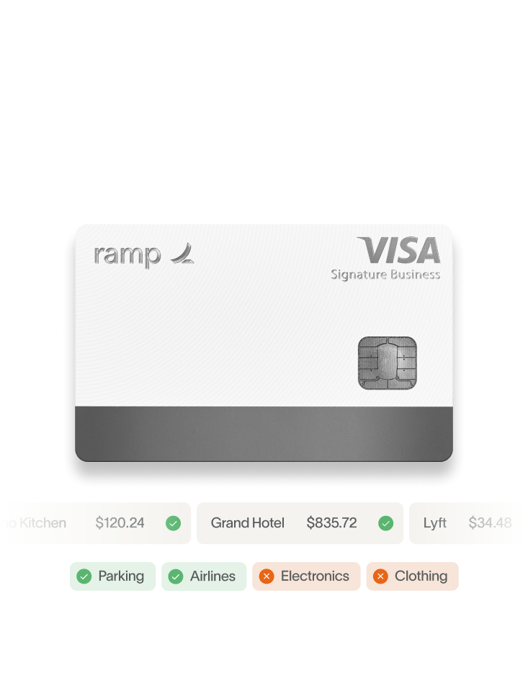
Ramp is a finance automation platform for modern businesses
We help companies control spend, automate accounting, and manage vendors together in one place; We help the average customer save 5% per year on expenses.
Awards:
#1 Most Innovative North America Company
The Fintech 50 List 2024
CNBC Disruptor 50 List 2023
Time 100
#1 Startup in America
30,000+
customers
$20B+
payments processed annually
$1B+
customer savings since 2019
195+
countries supported
125+
currencies supported
10M+
hours saved since 2019

Slide 8
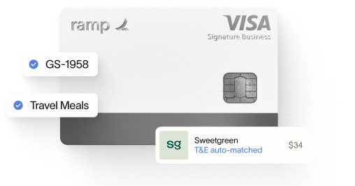
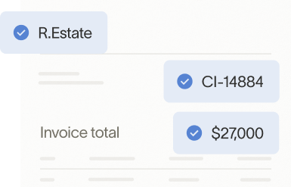
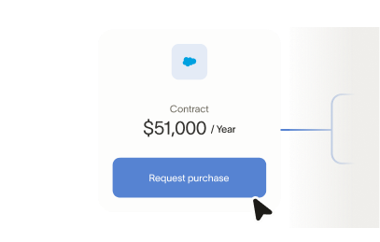
Ramp is more than just expense management
Accounting integrations
Corporate cards
Accounts payable
Procurement
Expense management
Travel

Slide 9
Ramp: The central hub for streamlining financial operations
HRIS
Accounting ERP
Corporate cards
Expense and travel management
Procurement and accounts payable
Bank
Business Tools

Slide 10
The SMB business finance stack are siloed, but Ramp can help consolidate
Category
Common Startups &
SMB Applications
Common Mid Market & Enterprise Applications
Ramp
Corporate Cards
Expense & Travel Management
Spend Management
AP & P2P
Direct ACH
Accounting & ERP
Advanced ERP
Integrations
Banking
Regional Banks
80+ Bank
Integrations

Slide 11
Where Ramp fits into the tech stack by Customer Annual Revenue
Annual revenue < $50M
Annual revenue $50-300M
Annual revenue > $300M
HR Management: Workday
HR Management: Workday
HR Management: Workday
Corporate Cards: Ramp
Corporate Cards: Ramp
Corporate Cards: Ramp
Expense Management: Ramp
Expense Management: Ramp
Expense Management: Ramp
Accounts Payable: Ramp
Accounts Payable: Ramp
Accounts Payable: Tipalti
ERP System: NetSuite
ERP System: NetSuite
ERP System: NetSuite
Travel Booking System: Ramp
Travel Booking System: Navan
Travel Booking System: Navan
Procurement System: Ramp
Procurement System: Coupa
Procurement System: Coupa

Slide 12
Where Ramp WILL fit into the tech stack by Customer Annual Revenue
Annual revenue < $50M
Annual revenue $50-300M
Annual revenue > $300M
HR Management: Workday
HR Management: Workday
HR Management: Workday
Corporate Cards: Ramp
Corporate Cards: Ramp
Corporate Cards: Ramp
Expense Management: Ramp
Expense Management: Ramp
Expense Management: Ramp
Accounts Payable: Ramp
Accounts Payable: Ramp
Accounts Payable: Ramp
ERP System: NetSuite
ERP System: NetSuite
ERP System: NetSuite
Travel Booking System: Ramp
Travel Booking System: Ramp
Travel Booking System: Navan
Procurement System: Ramp
Procurement System: Ramp
Procurement System: Coupa

Slide 13
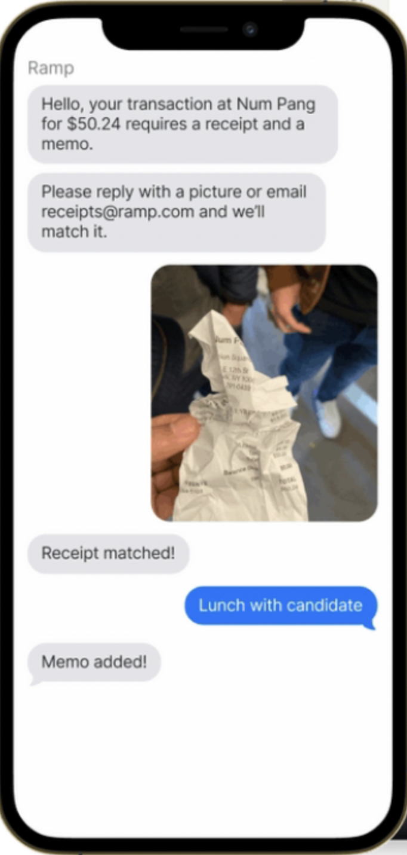
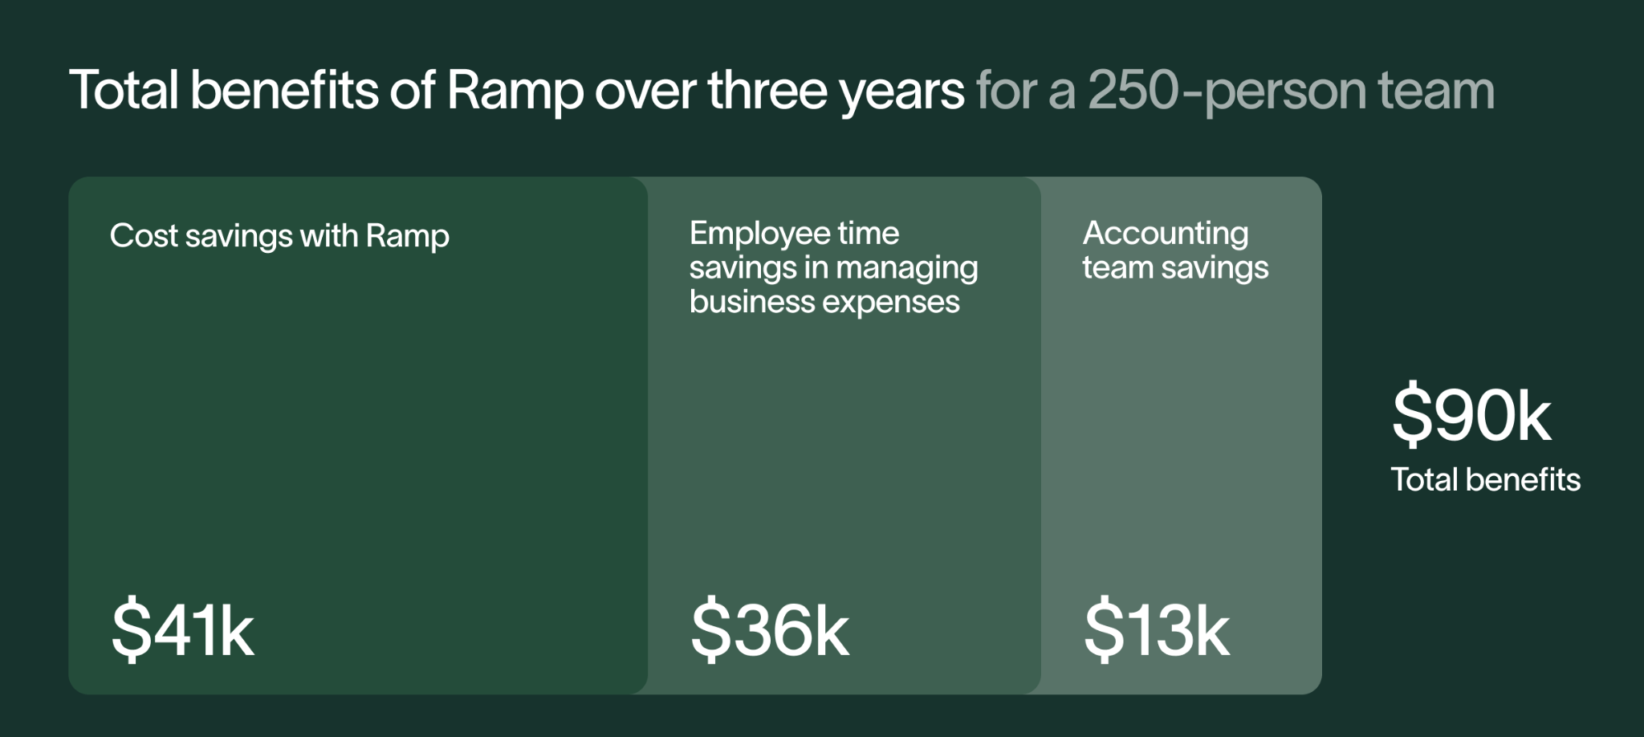
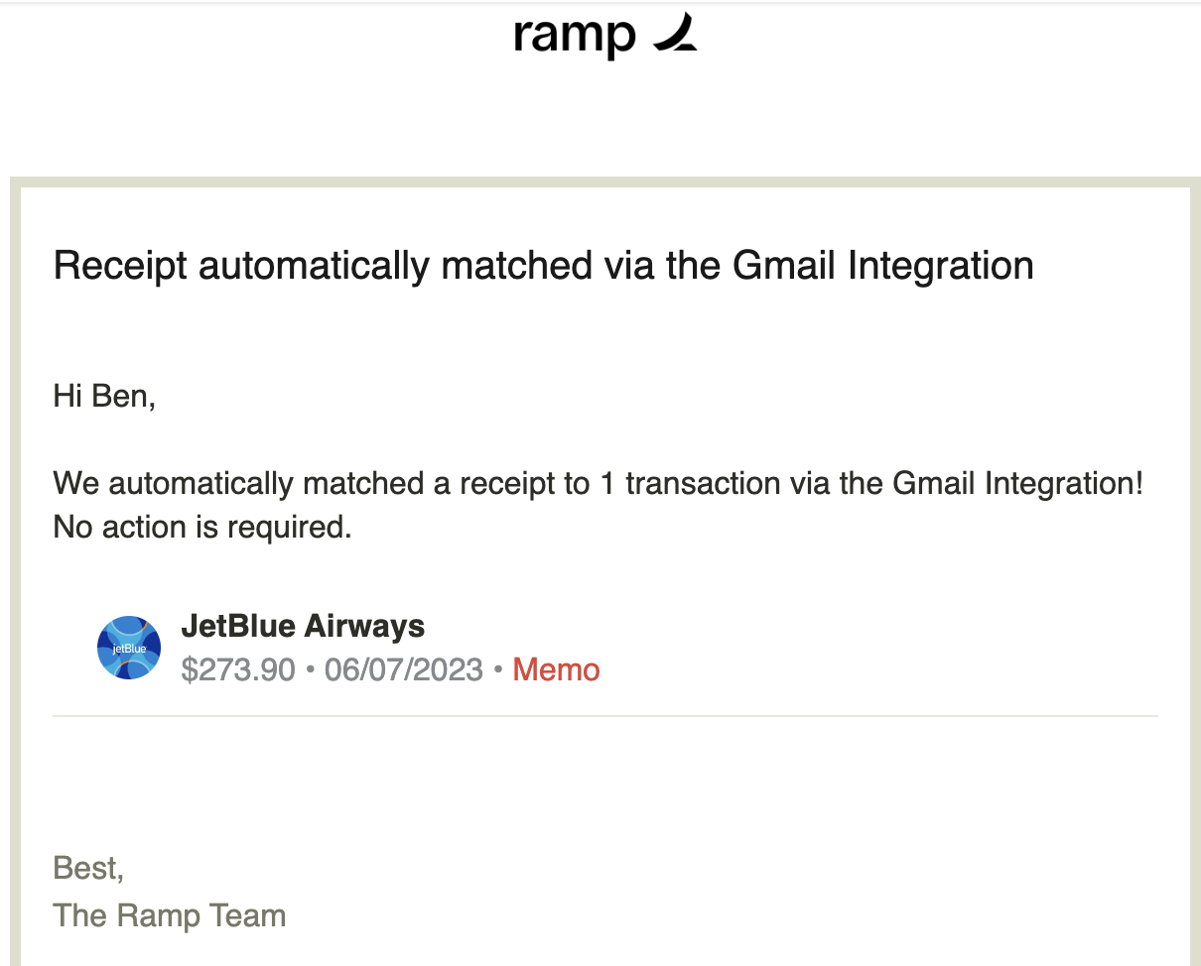
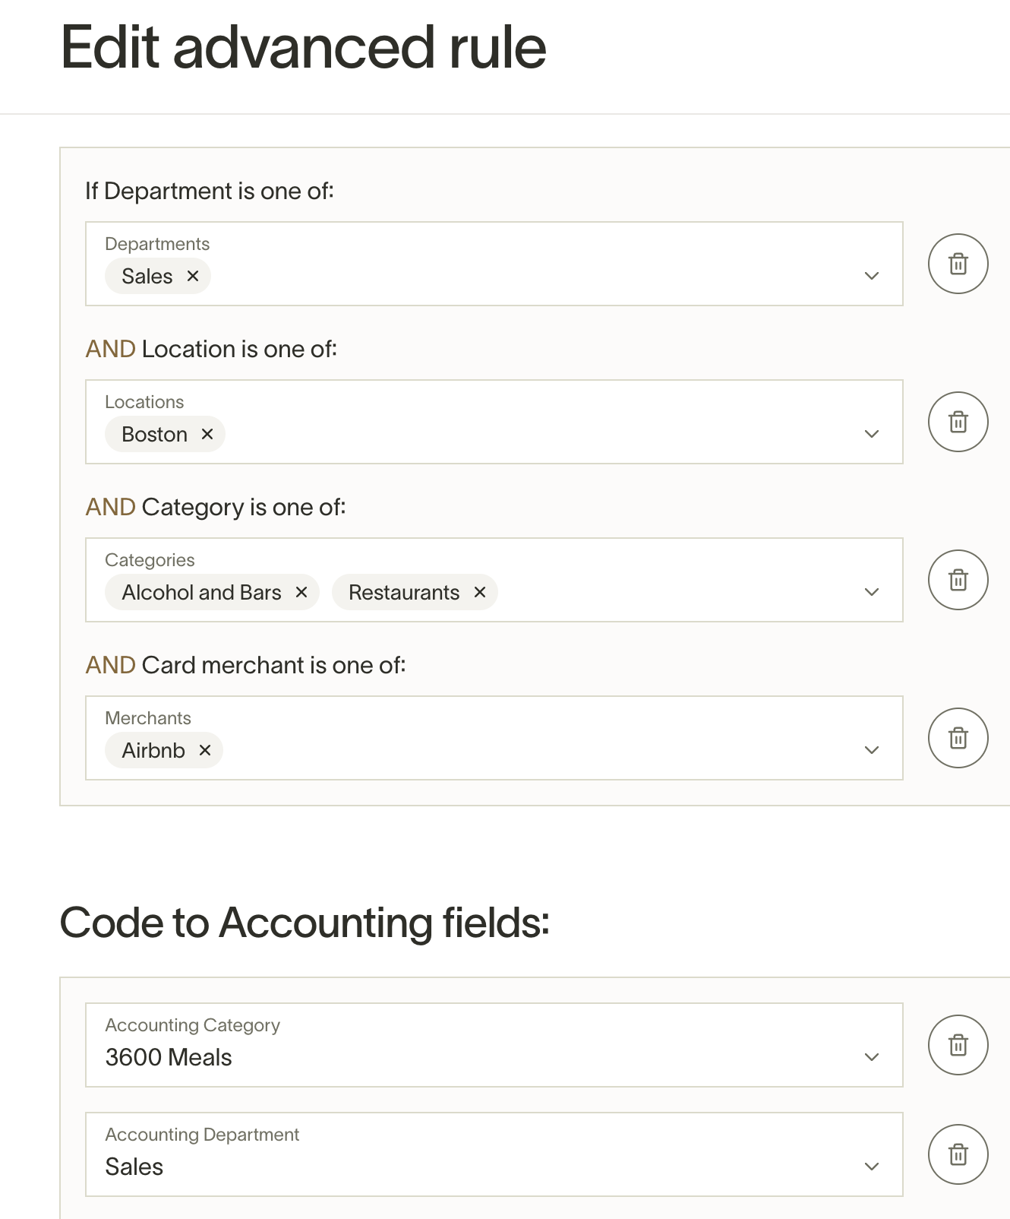
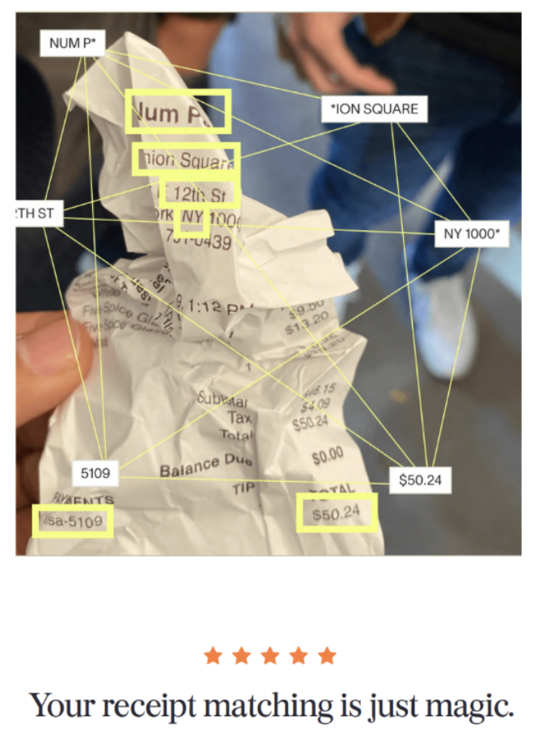
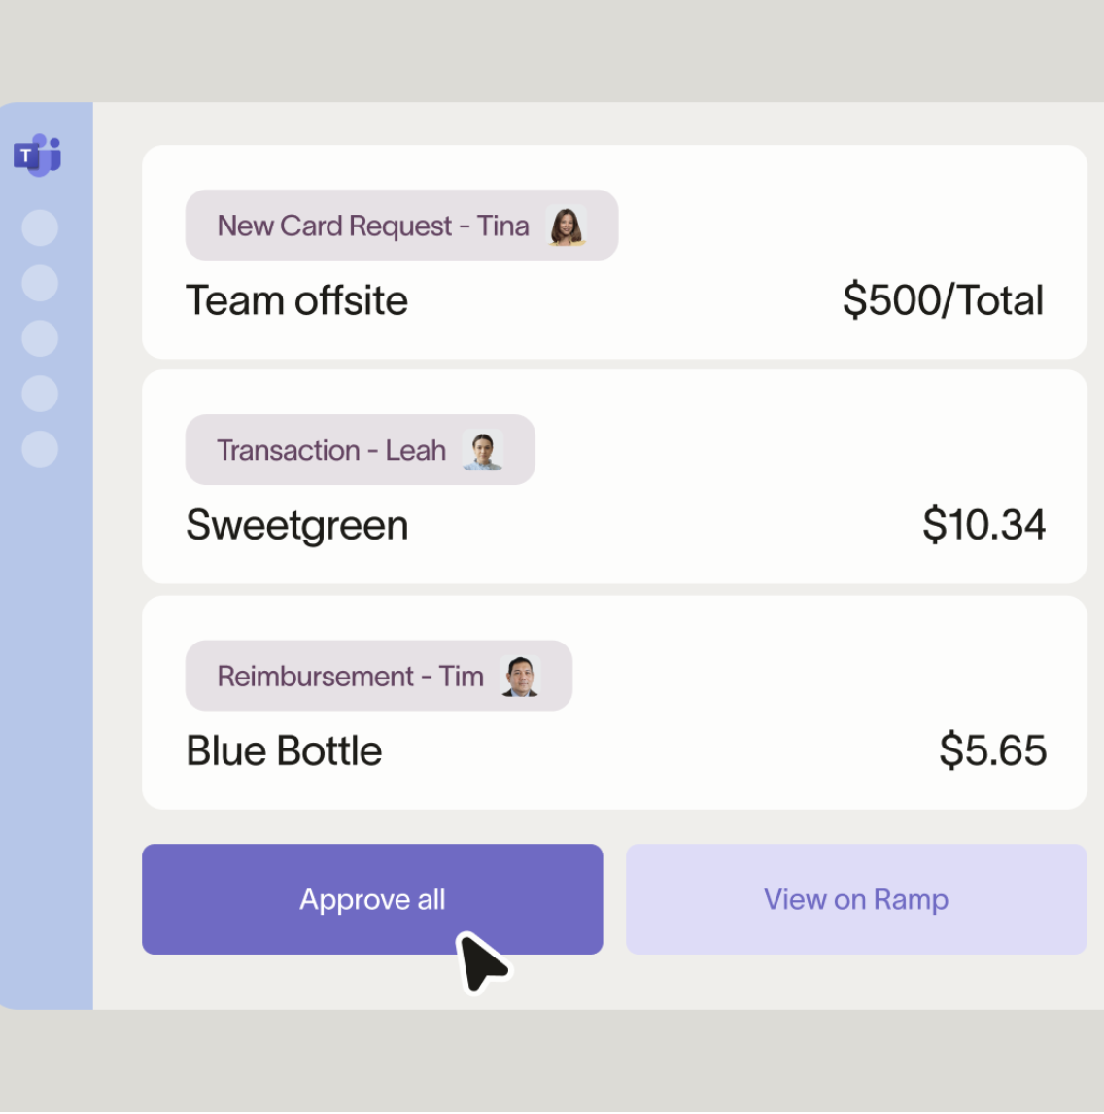
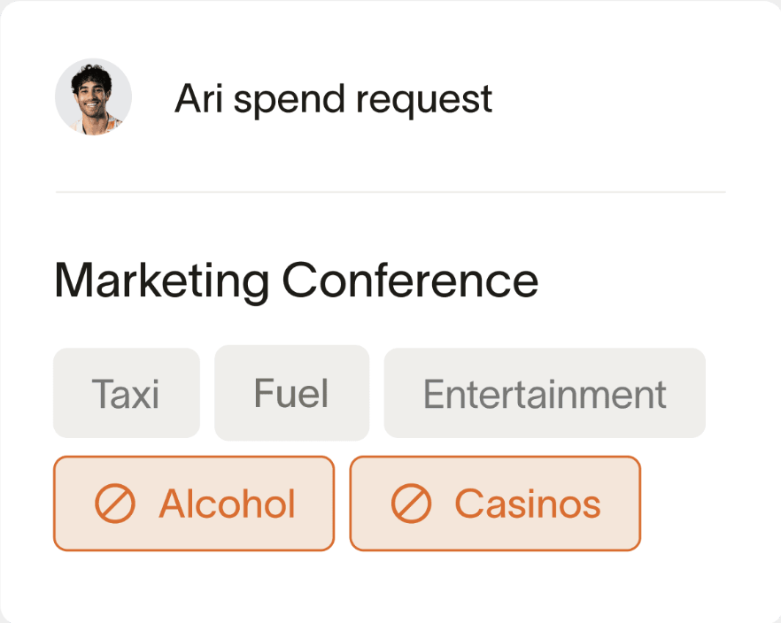
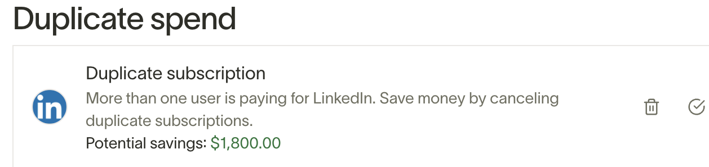
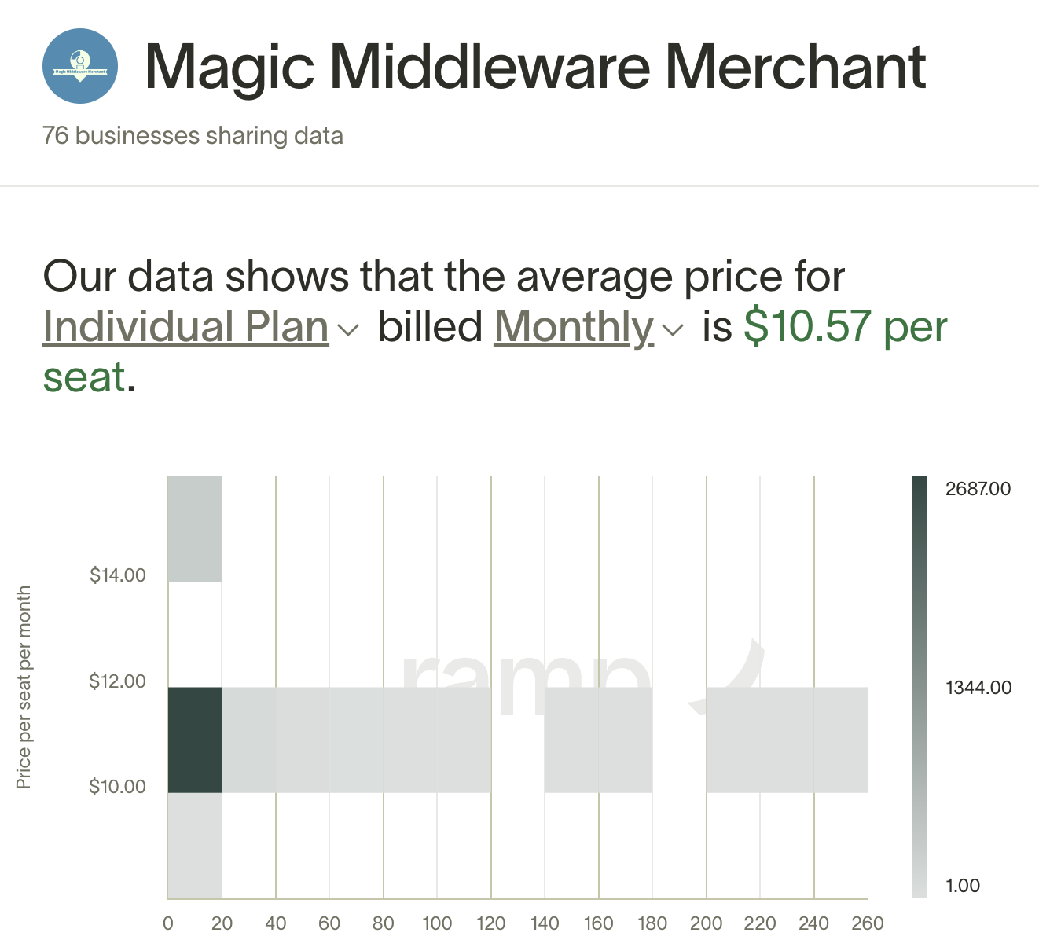
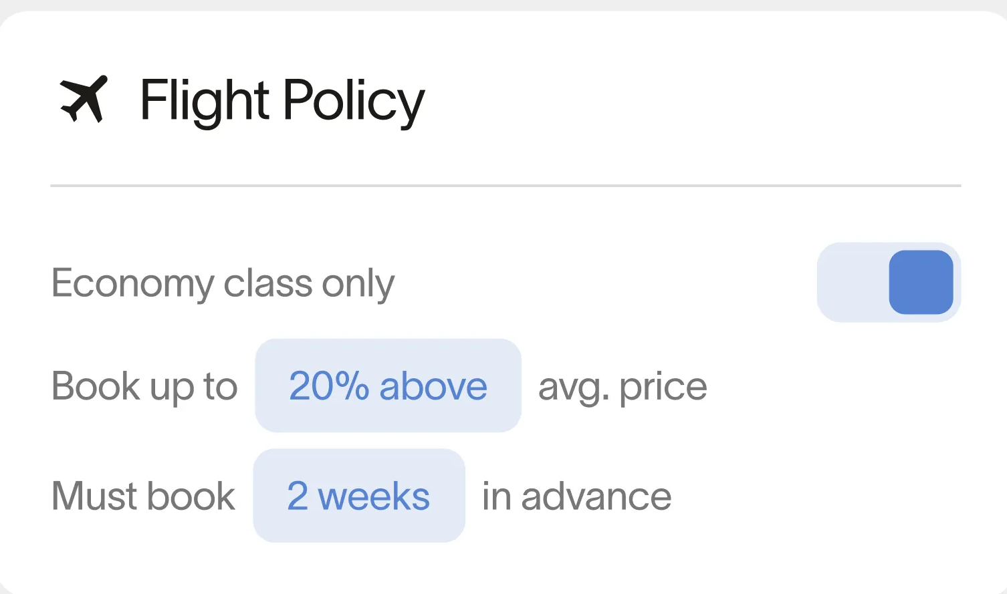
Economic impact of Ramp
5,400 hours back to all cardholders annually
Commissioned study conducted by Forrester Consulting in 2024
1,200 hours back to accounting teams
5% annual savings on expenses

Slide 14
Challenges in NetSuite spend management/bill pay

Slide 15
Current 2024 functionality for NetSuite’s AP automation tool.
Capture Engine
Payment Functionality
Minimal automated coding capabilities
Custom field input requires extra step
No Multi-currency/foreign language capabilities
Dupe detection? Only AFTER creating the bill
Limit on # of lines or pages on invoice
Must use HSBC bank.
Separate bank account needed for each subsidiary
Fees with banking service
No international wires
Need to migrate vendor information to “payment automation” module
Daily transaction limits on ACH and Card

Slide 16
Ramp vs NetSuite AP
Use your bank, not just HSBC
Bill capture and OCR functionality for unlimited # of lines and emails
Functionality to support multi-subsid, multi-currency & custom fields
Ramp vs NetSuite size, speed, focus
Notes:
Netgain works with 200 partners in the NetSuite Ecosystem
Bryant park has closed 8 deals across multiple Netgain products.
shaved multiple days off of a client's close process with NetClose,
automated hundreds of monthly intercompany allocations with Shared Transactions for a client,
and helped move fixed asset management into NetSuite with NetAsset for a client
Netgain Certified Implementers at BPC
2 for NetAsset
1 for Shared Transactions
Customer spotlight for BPC
Highlighted client is a full-service custom merchandise company that specializes in creating high-quality branded products for businesses. Their offerings include promotional items, custom apparel, and corporate swag tailored to enhance brand visibility and engagement.
Pain Points
Company in need of connecting their 50 Shopify storefronts producing 200,000 orders a month to NetSuite. Also in need of connecting NetSuite to ShipStation.
Experienced challenges with previous vendors of sending an item fullfilment NetSuite record to ShipStation.
Why Netgain (SuperSync Integrations) + BPC
Ability to easily address their previously challenging item fullfilment need
Affordability of the licenses even with the high volume of storefronts

Slide 17
Ramp demo
What we'll cover:
Ramp Cards & Expense Management
From user level
From admin level
Ramp Procurement/AP/Bill Pay
Ramp + NetGain Shared Transactions

Slide 18
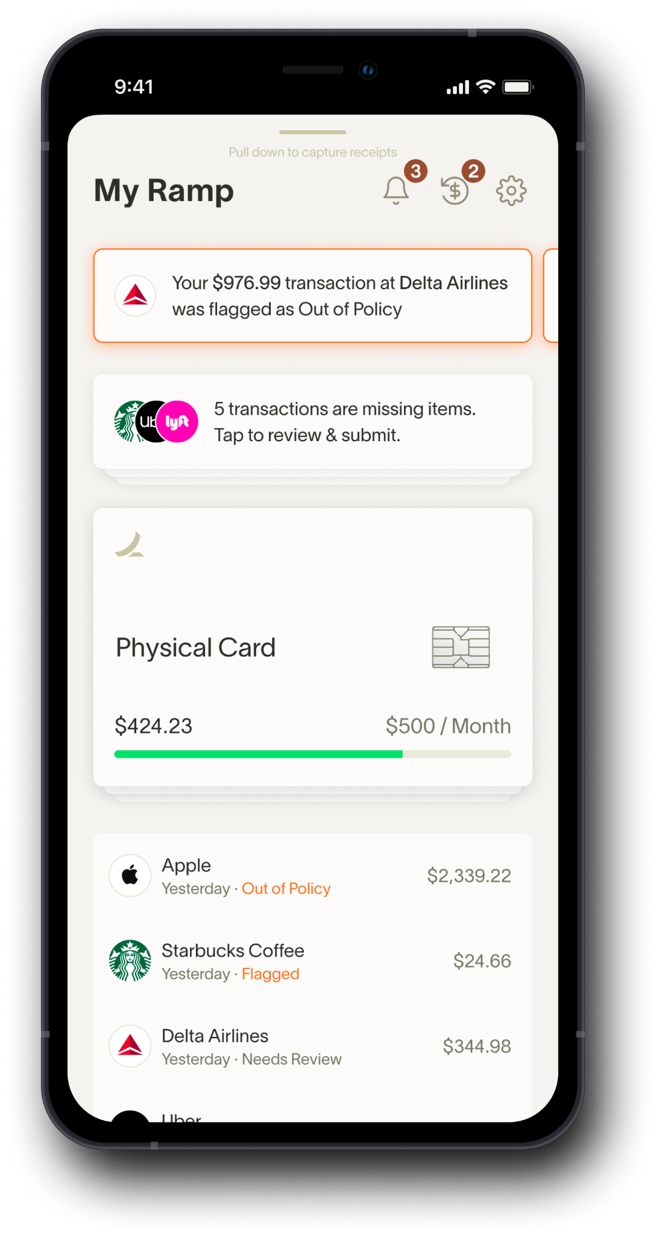
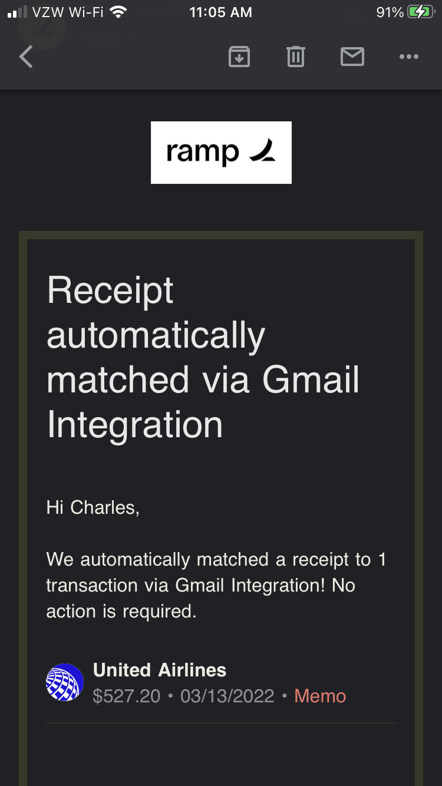
Zero-touch expenses
SMS
Mobile App
Integration

Slide 19
Netgain customer sign up bonus
Learn more about Ramp's easy-to-use finance operations platform with easy-to-use cards, spend limits, approval flows, vendor payments— and more.
$500 Sign up bonus
Sign Up Here
*Bonus will be paid via Amazon eGift Card after your first balance payment of $1,000 within 90 days of account opening

Slide 20
Contact us!
Nigel Reiff
nreiff@ramp.com
Gabriel Rogoff
grogoff@ramp.com

Slide 21
Q&A

