Slide 1
Pre-launch lunch and learn for partners
Empower your clients with automated intercompany vendor bills

Slide 2


Netgain team
Casey Stewart
Morgan Hunsaker
Director of partnerships
Product manager
Certified Public Accountant
Big 4 and IPO consulting
background
Product expert at Netgain
Master of Accountancy with Big 4 background
MBA graduate from the Kellogg School of Management

Slide 3
Shared Transactions: Automating arm’s length compliance
Introduction
Intercompany vendor bill automation
Use cases and ideal customer profile
Effective product positioning
Live demo
Q&A

Slide 4
The manual intercompany process
Arm's length compliance
In a multi-entity or multinational environment, transactions between related entities (like subsidiaries of the same parent company) must be conducted as if they were between unrelated parties.
Generate an invoice
Create a corresponding vendor bill
Both subsidiaries confirm that amounts match exactly
Maintain supporting documentation and audit trails

Slide 5

Challenges
Time-consuming – Matching invoices & vendor bills by hand takes hours
Error-prone – Manual data entry leads to compliance risks
Inefficient – High transaction volumes slow down finance teams
Regulatory burden – Arm’s-length compliance requires a structured process

Slide 6
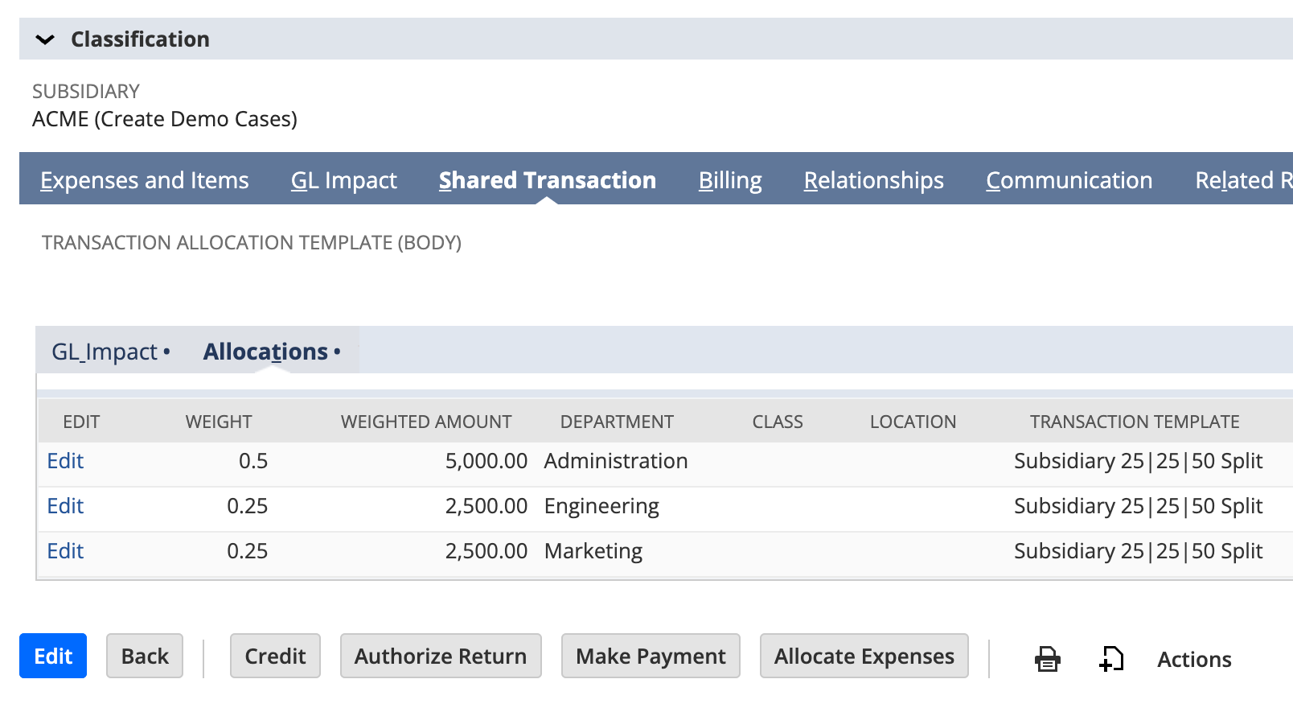
NETSUITE
Shared Transactions
Split, allocate, and automate transaction entries in NetSuite.
Challenges: Manually splitting transactions across subsidiaries or segments in NetSuite is slow and error-prone, leading to delays and reporting headaches.
How Shared Transactions helps:
  Save time on manual work by automating transaction allocations across subsidiaries and segments, freeing up your finance team for higher-value tasks.
  Increase accuracy and reduce errors with automated rules that ensure precise allocations every time.
  Achieve a faster close by eliminating manual adjustments.
AUTOMATED ALLOCATIONS
BUILT IN NETSUITE
INTERCOMPANY VENDOR BILL AUTOMATION
Accelerate close times by automating intercompany and multi-segment allocations directly in NetSuite — no more manual adjustments.
Take a Tour of Shared Transactions →
Notes:
🟠 Shared Transactions Overview
Problem: Manually splitting transactions across subsidiaries or segments in NetSuite is slow and error-prone, leading to delays and reporting headaches.
Solution: Shared Transactions enables automated, rules-based allocation of transactions to multiple subsidiaries and segments directly in NetSuite—saving time, reducing errors, and improving financial accuracy.
Core Benefits:
Native to NetSuite
Reduced reliance on manual entries
Real-time visibility and traceability
Streamlined cross-entity coordination
Automatic intercompany vendor bill creation*
Enhanced compliance for international transactions*
* Notes benefits specific to intercompany vendor bill automation
🟠 Script:
Manually splitting transaction entries between subsidiaries or segments can feel like chasing down every detail just to keep your books balanced. It’s repetitive, slow, and leaves room for costly errors.
That’s where Shared Transactions comes in.
With automated allocation rules, intercompany transaction support, and multi-segment splitting, Shared Transactions takes the burden off your team. It streamlines allocations, eliminates manual entries, and keeps your records audit-ready—all directly in NetSuite.

Slide 7
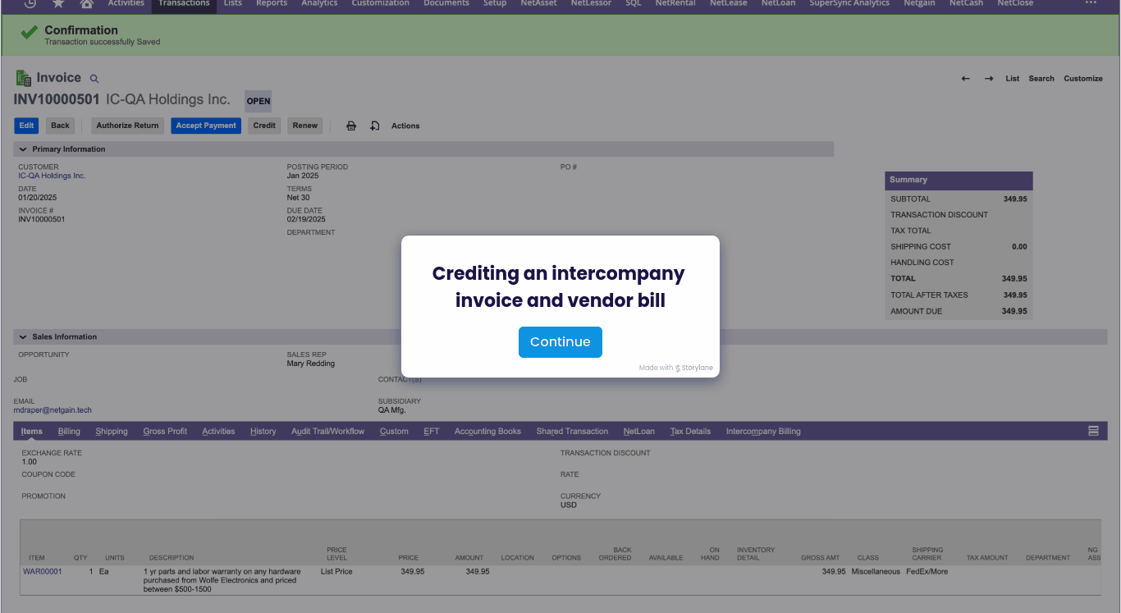
NETSUITE
Shared Transactions
Automatically create matching vendor bills for intercompany invoices
Challenges: For global companies, Arm's Length rules require that intercompany transactions be treated as if they occurred between unrelated parties. This means that for every intercompany invoice, there must be a corresponding vendor bill.
How Shared Transactions helps:
  Save time on manual work by automating vendor bill creation, freeing up your finance team for higher-value tasks.
  Increase accuracy and reduce errors with automated rules that ensure precise allocations every time.
  Achieve a faster close by eliminating manual adjustments.
BUILT-IN COMPLIANCE
NATIVE TO NETSUITE
INTERCOMPANY VENDOR BILL AUTOMATION
Accelerate processes in NetSuite — no more manual billing for intercompany transactions, saving hours of work each month.
Take a Tour of Shared Transactions →
Notes:
🟠 Shared Transactions Overview
Problem: Manually splitting transactions across subsidiaries or segments in NetSuite is slow and error-prone, leading to delays and reporting headaches.
Solution: Shared Transactions enables automated, rules-based allocation of transactions to multiple subsidiaries and segments directly in NetSuite—saving time, reducing errors, and improving financial accuracy.
Core Benefits:
Native to NetSuite
Reduced reliance on manual entries
Real-time visibility and traceability
Streamlined cross-entity coordination
Automatic intercompany vendor bill creation*
Enhanced compliance for international transactions*
* Notes benefits specific to intercompany vendor bill automation
🟠 Script:
Manually splitting transaction entries between subsidiaries or segments can feel like chasing down every detail just to keep your books balanced. It’s repetitive, slow, and leaves room for costly errors.
That’s where Shared Transactions comes in.
With automated allocation rules, intercompany transaction support, and multi-segment splitting, Shared Transactions takes the burden off your team. It streamlines allocations, eliminates manual entries, and keeps your records audit-ready—all directly in NetSuite.

Slide 8




Ideal client profile
Key indicators your clients would be a good fit for this functionality
International companies
High transaction volumes
Strict compliance requirements
Shared Transactions customers
Companies with multiple subsidiaries or global operations
Companies creating many intercompany invoices each month
Companies required to follow Arm's Length compliance
Companies already using Netgain's Shared Transactions solution

Slide 9
Partner positioning
Lead with efficiency gains
Emphasize compliance and audit-readiness
Bundle with existing services
Offer best practice consultation

Slide 10
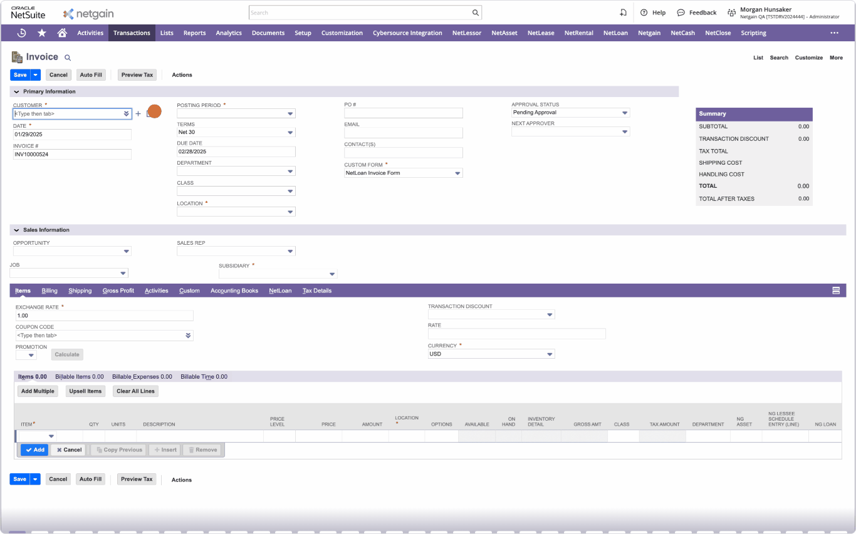

Slide 11
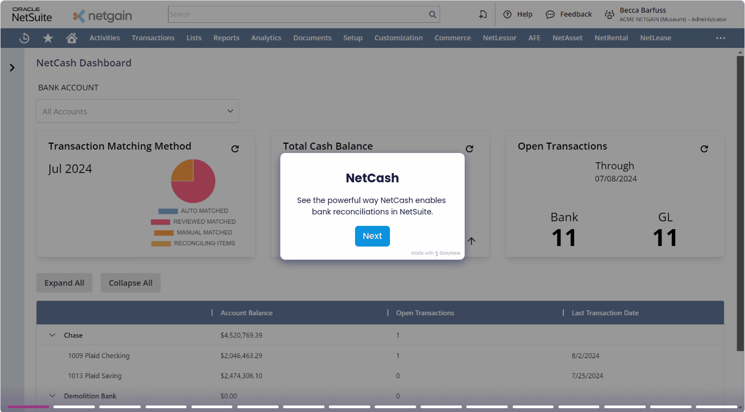
Resources coming to you
1. Partner promotional package
Click-through demo, sales email template, marketing blurb for newsletters, one-pager
2. Partner webpage
One-stop shop for product documentation, FAQs, and marketing collateral
3. Partner product cheat sheets
Includes key talking points, benefits, and technical prerequisites
4. Personalized support & training
Implementation certification training

Slide 12
Q&A

Slide 13
Thank you!
Look for an email after this webinar with links to all these resources, plus a recording of today’s session.

