Slide 1
Unlocking ROI with Netgain
A partner’s path to success

Slide 2
Speakers
Jeff Swan
Casey Stewart
Kevin Comoletti
Svp of partners and alliances
Director of Partnerships
Sales manager
18 Years With NetSuite
Former CRO at AP Software SDN Partner
Certified Public Accountant
Big 4 and IPO Consulting Background
Netgain's SuperSync and Business apps lead
Former NetSuite Solution Consultant and Implementer
Jeff Swan
Casey Stewart, CPA
Kevin Comoletti

Slide 3
A partner's path to success
How to overcome common challenges
Partner spotlight
Resources available
SuperSync highlight
Q&A
Survey winner announcement

Slide 4
Challenges faced by partners: Insights & Solutions
Using the partner support email effectively
Getting started with implementation
How to bundle products effectively
Identifying your Netgain partner contact

Slide 5
Partner spotlight
Partner since 2021
Netgain certified implementers
8 successful deals across multiple products
NetClose
Shared Transactions
NetAsset
SuperSync integrations
Notes:
Netgain works with 200 partners in the NetSuite Ecosystem
Bryant park has closed 8 deals across multiple Netgain products.
shaved multiple days off of a client's close process with NetClose,
automated hundreds of monthly intercompany allocations with Shared Transactions for a client,
and helped move fixed asset management into NetSuite with NetAsset for a client
Netgain Certified Implementers at BPC
2 for NetAsset
1 for Shared Transactions
Customer spotlight for BPC
Highlighted client is a full-service custom merchandise company that specializes in creating high-quality branded products for businesses. Their offerings include promotional items, custom apparel, and corporate swag tailored to enhance brand visibility and engagement.
Pain Points
Company in need of connecting their 50 Shopify storefronts producing 200,000 orders a month to NetSuite. Also in need of connecting NetSuite to ShipStation.
Experienced challenges with previous vendors of sending an item fullfilment NetSuite record to ShipStation.
Why Netgain (SuperSync Integrations) + BPC
Ability to easily address their previously challenging item fullfilment need
Affordability of the licenses even with the high volume of storefronts

Slide 6
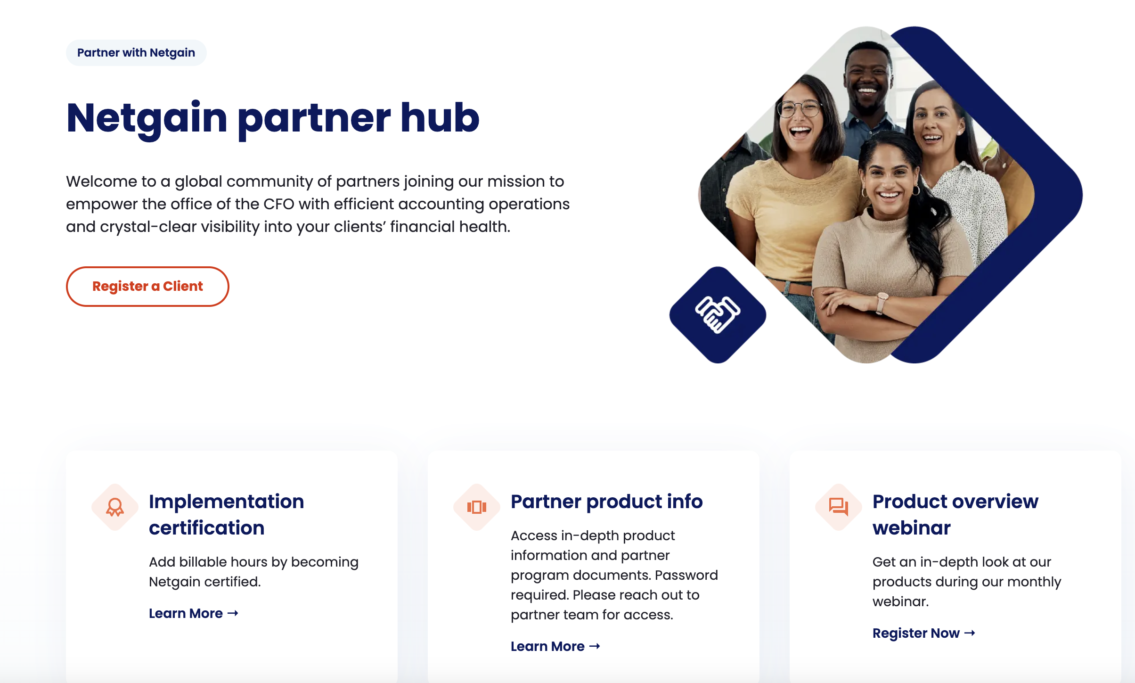
Partner Page
Partner product info password- NetPartner

Slide 7
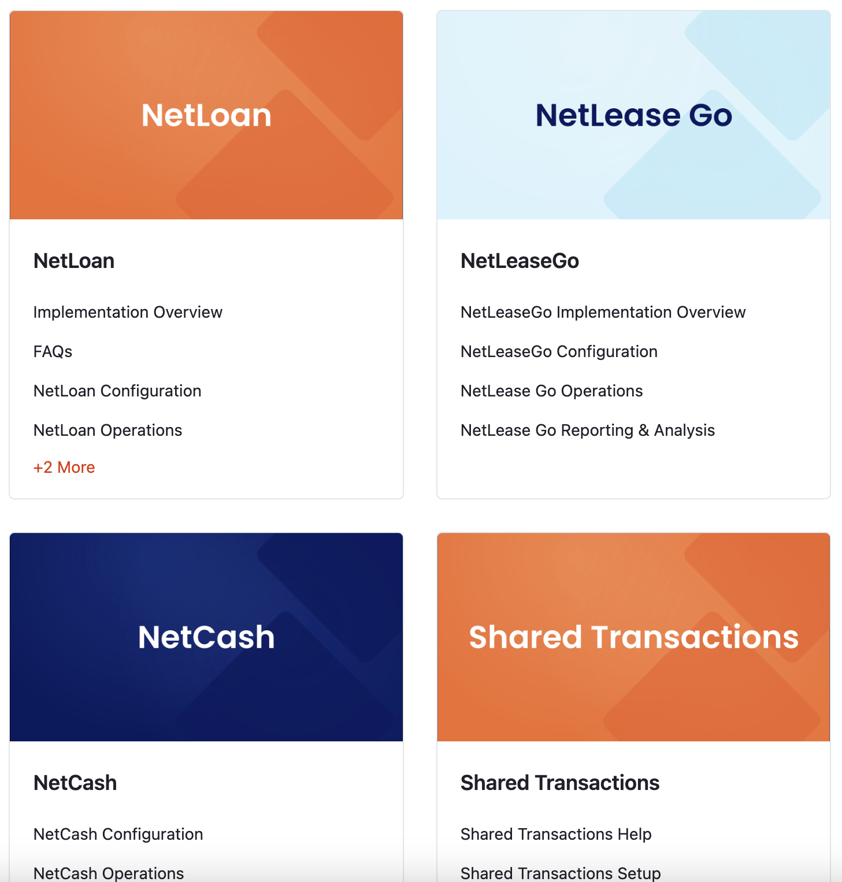
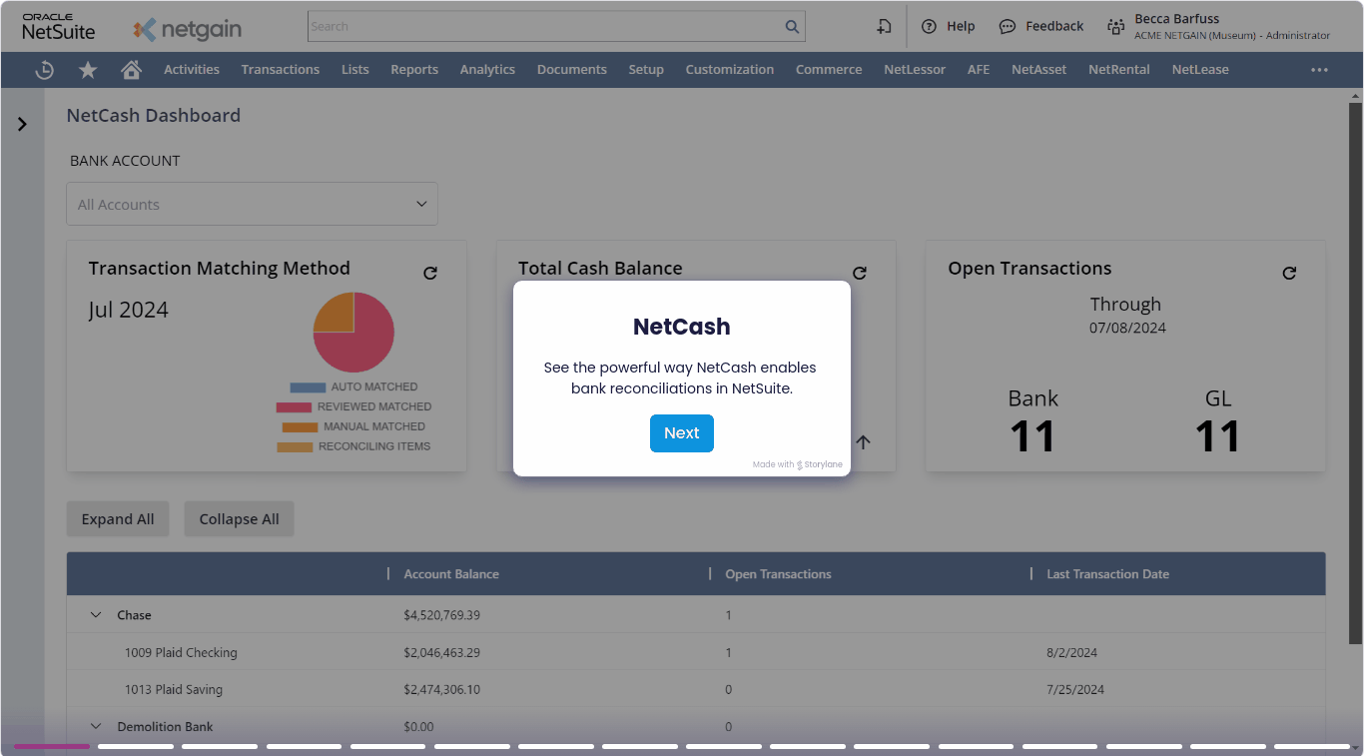
Resouces available to you
Click-through demos
Product videos
Knowledge base articles

Slide 8
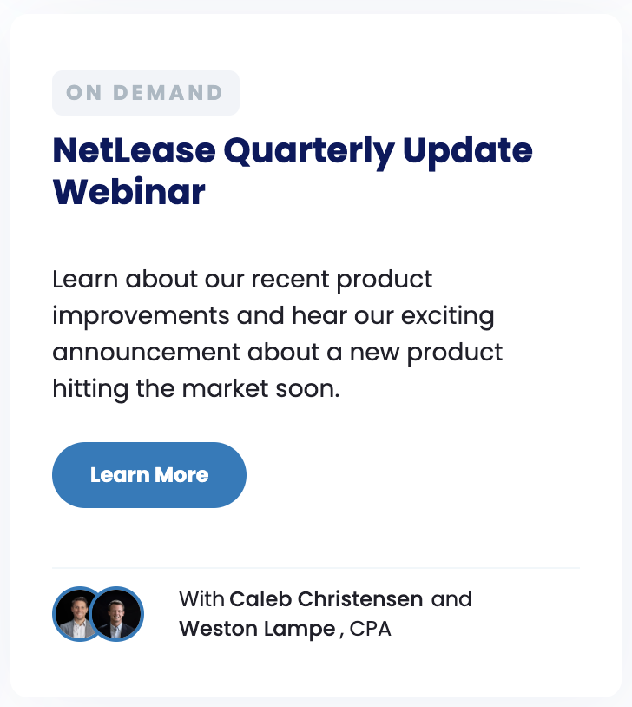
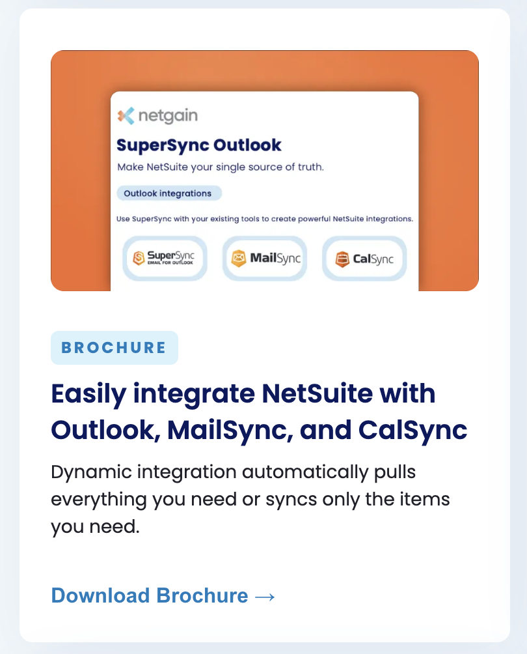
Resources available to you
Webinar recordings
Product one-pagers
Blog posts

Slide 9
New 2024 Netgain products: SuperSync
SuperSync Integrations
SuperSync PunchOut
SuperSync Files

Slide 10
Integrations - Ecommerce
SuperSync eCommerce integrations enable synchronization of orders, shipments, refunds, and inventory between NetSuite and eCommerce platforms.

Slide 11
Integrations - 3PL
SuperSync 3PL integrations enable synchronization of orders, fulfilment, returns, and inventory between NetSuite and eCommerce platforms.

Slide 12
Other integrations
The SuperSync platform enables the synchronization of data between NetSuite
and a variety of platforms.

Slide 13
Punchout
Key Features and Benefits
Speeds up PO creation and transmission to suppliers
Expedites order fulfillment by suppliers
Prevents data entry errors on part numbers and quantities
Ensures exact supplier pricing or negotiated prices are used on PO
Improves distributed purchasing processes and decreases work for central procurement
Punchout is a method of automating the creation of POs by directly building a cart on a supplier site and then pushing the cart back to the ERP or Procurement system as a pending PO.
It is supported by any supplier site that uses cXML and can save customers a lot of time.​
The Punchout for NetSuite application enables "Punchout" purchasing for streamlined creation of Purchase Orders within NetSuite and electronic transmission of approved POs back to suppliers.

Slide 14
Common vendors
Notes:
Updated 4/15/2024. Go to Sales > Sales Toolkit > Demo Success > SCS Apps > SCS Products Help for full list of vendors we have proven integrations with. Reminder – any vendor that supports cXML can be integrated with though.

Slide 15
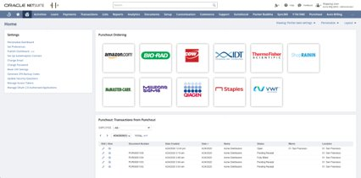
Punchout for NetSuite
Access vendors through tiles on NetSuite’s Dashboard
User clicks on a tile to be automatically logged into supplier eCommerce site in "Punchout" mode
User adds items with desired quantities to cart
"Transfer Cart" button pushes order back into NetSuite and auto generates PO
PO goes through approvals process
Once approved, PO is automatically sent to supplier for fulfillment

Slide 16
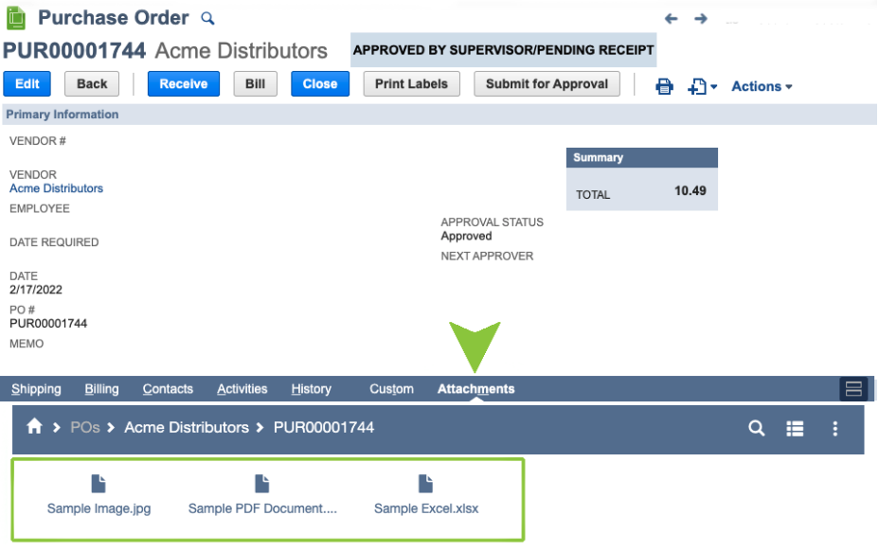
SuperSync files
SuperSync files integrates documents between NetSuite and SharePoint or Google Drive.
The Documents Connector provides an alternative to storing documents in the NetSuite file cabinet and enables drag and drop file management via standard NetSuite forms.

Slide 17
Features & benefits
Main Features
Key Benefits
• Connects to Google Drive and SharePoint
• Documents icons are displayed in a sub-tab directly on the NetSuite record
• Supports any record type in NetSuite, including transactions and custom record types
• Files are stored in an external file hosting service
• Makes it easier to share documents with other areas of your company through comprehensive file hosting platforms
• Storing documents outside of NetSuite saves your company on accrued file cabinet fees
• User-friendly, simply drag and drop documents directly via NetSuite

Slide 18
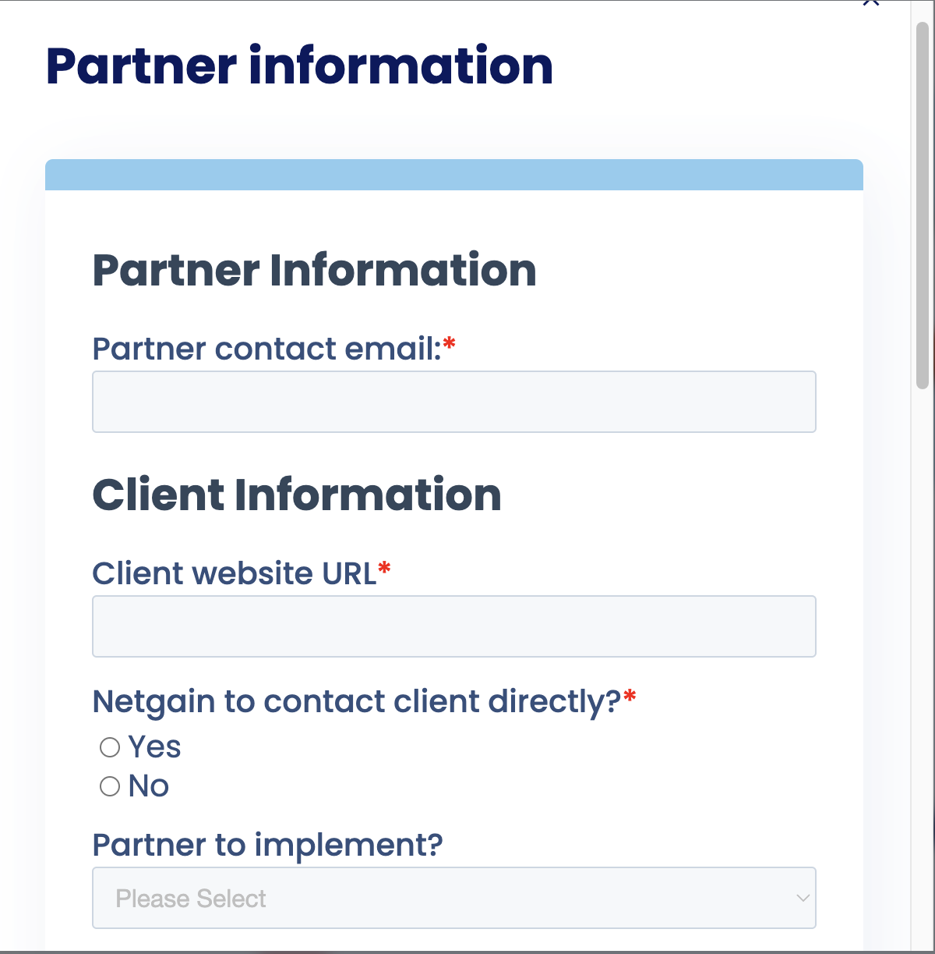
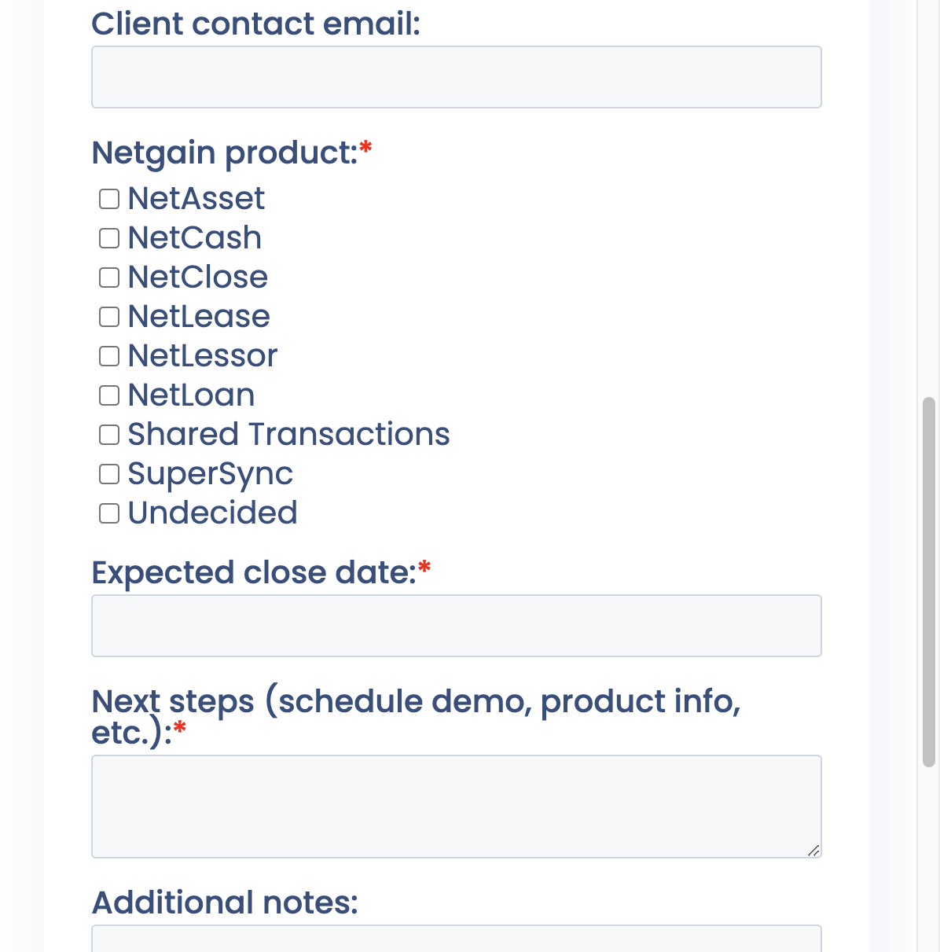
Register a client!

Slide 19
Q&A

Slide 20
$200 amazon gift card survey winner
Adam Rader
Centric Consulting, LLC

Slide 21
Unlocking ROI with Netgain
A partner’s path to success
Link to Netgain Partner Page

